Slide 1
Chip and Skim cloning EMV cards with the pre-play attack
Mike Bond, Omar Choudary, Steven J. Murdoch, Sergei Skorobogatov, Ross Anderson
Cambridge University
Presented by: Anwar Alqutan

Slide 2
Outline
Background
The smoking gun
EMV Transaction
Random Numbers
Pre-play attack
Weak RNG
Protocol Flow
Defenses
Conclusion

Slide 3
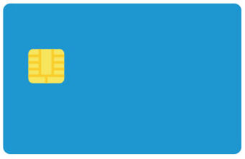
Background
EMV (Chip and PIN) stands for Europay, MasterCard and Visa
The leading system for card payments worldwide
Developed in 1990s to tackle the developing threat of magnetic stripe card counterfeiting
More than 1.62 billion cards in use worldwide
EMV cards contains a smart cards that store their data on integrated circuits (IC) in addition to magnetic stripes
The payment terminal executes the EMV protocol with the chip, which exchanges selected transaction data sealed with a cryptographic message authentication code (MAC) calculated using a symmetric key stored in the card and shared with the bank(issuer)
The bank should be able to detect a counterfeit card that does not contain this key
The physical tamper-resistance of the chip prevent an attacker from extracting the key
The chip protects against card counterfeiting
The PIN against stolen card abuse

Slide 4
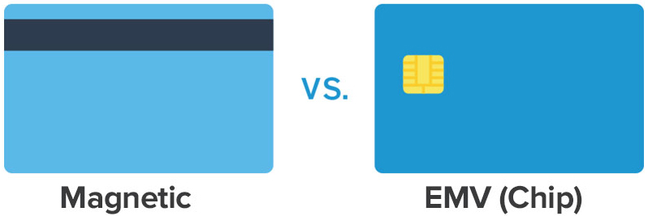
EMV and Magnetic Stripe
Why EMV?
Improved security over existing magnetic stripe technology
Chip cards are difficult to clone (prevent fraud)
Offline card verification and transaction approval
Multiple applications on one card

Slide 5
Liability Shift
The cardholders are assumed to be liable unless they can unquestionably prove they were not present for the transaction, did not authorize the transaction, and did not inadvertently assist the transaction through PIN disclosure
Since the introduction of EMV, the banks have operated a “liability shift”
When a transaction is disputed!
if a PIN was used the customer is held liable
if no PIN was used the transaction is charged back to the merchant
Regardless of the fact that the no-PIN attack falls into this category
The 2008/2009 British Crime Survey found that 44% of fraud victims didn’t get all their money back

Slide 6
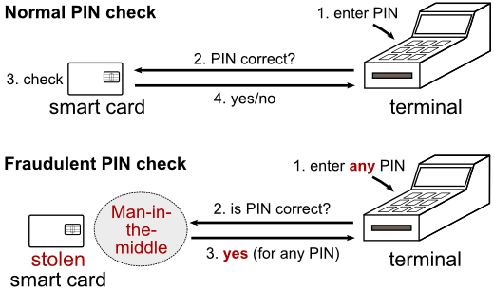
EMV & Attacks
EMV did not cut fraud as its proponents predicted
Moved to “card-not-present” transactions
Started making magnetic-strip clones of EMV cards
No-PIN attack

Slide 7
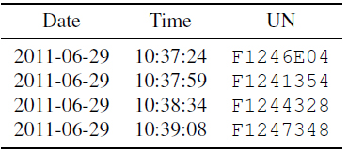
The Smoking Gun
Banks started to be more aggressive towards customers who complained of fraud
Victims would be denied compensation
The case which kicked off this research
Mr Gambin, a Maltese customer of HSBC who was refused a refund for a series of transactions
HSBC claimed must have been made with his card and PIN at an ATM in Palma, Majorca on the 29th June 2011
We advise the fraud victim to demand the transaction logs from the bank
We observed that one of the fields on the log file, the “unpredictable number” or UN, appeared to be increasing steadily
We wondered whether, if the “unpredictable number” generated by an ATM is in fact predictable
Might create the opportunity for an attack in which a criminal with temporary access to a card
compute the authentication codes needed to draw cash from ATM at some time in the future for which the value of the UN can be predicted. We call it “pre-play” attack.
We discovered that several ATMs generate poor random numbers, and that attacks are possible

Slide 8
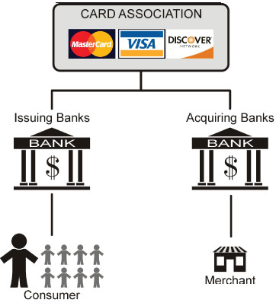
EMV Transaction
Card authentication
Card number, start & expiry dates, supported protocol options, static RSA digital signature
Cardholder verification
PIN or signature
Transaction authorization
ATM ► amount, currency, date, TVR, nonce (UN),…
CARD ► ARQC ≡ ATC, IAD, MAC(T,ATC,IAD)
Principals:
Card
ATM
Issuer

Slide 9
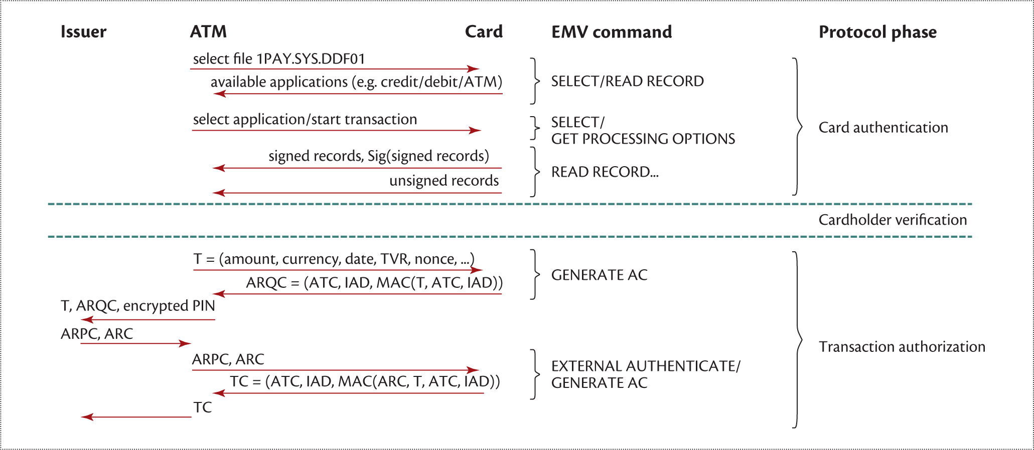
EMV Transaction at ATM

Slide 10
The Two Variants of Pre-play Attack
The ATM relies on the issuer to verify ARQC and authorize the transaction
Replaying an ARQC should not work, because a competent issuer prevents replay by rejecting any transaction whose application transaction counter (ATC) it has already seen
The ATC prevents simple replay attacks but cannot assure the issuer that the ARQC was computed today rather than yesterday
To ensure freshness, a nonce is used – the unpredictable number (UN) This is a 32 bit field generated by the ATM
We have discovered two major flaws that make the UN almost redundant:
Specification and engineering flaw that results in predictable UNs that can be exploited
EMV does not include the identity of the terminal
UN prediction or manipulation effectively results in a clone for a specific transaction
EMV protocol flaw, which allows an attacker to choose an arbitrary UN with the pre-play attack
The terminal generates the Unpredictable Number (UN) and not the backend
The issuing bank that relies on it

Slide 11
EMV and Random Numbers
In EMV transaction, the terminal sends a random number N to the card along with date D and the amount X.
The card computes an authentication request cryptogram (ARQC) on N, D, X
What happens if I can predict the N for D?
If I have access to your card I can precompute an ARQC for the amount X, and date D

Slide 12
Pre-play Attacks - Weak RNG - Implementation
An attacker collects the transaction data (ARQC) from a genuine transaction
Data is re-played when the UN matches
Limitation: country, amount and date must match the original transaction
A valid PIN is, theoretically, only required for ATMs (forced online verification)

Slide 13
Pre-play Attacks - Weak RNG - Detection
Transaction back-ends should validate the freshness of UNs and detect implementation errors and/or pre-plays
The implementation of Application Transaction Counter (ATC) validation would raise an alarm in case of re-use

Slide 14
Experimental Method and Results
Modified a bank smart card for data collection to identify ATMs with poor UN generation
Analysis of log files
Logs from the bank for customer in dispute
UN data from Italy, UNs are routinely printed on all customer receipts
Active probing of ATMs
Constructed a set of passive monitoring cards containing real EMV chip, with monitoring microcontroller and flash storage
Reverse engineering ATM code
Acquired two real machines for analysis
We test & find half of ATMs use counters! (fast-moving counter)

Slide 15
Experimental Method and Results cont..
To collect card data we have implemented a Python EMV terminal implementation and modified an EMV terminal
For each card a set of ARQCs can be harvested
To carry out the attack we implemented a cloned card

Slide 16
Pre-play Attacks - Protocol Flaw
Even if the UN generation algorithms are patched, a number of protocol attack variants may make pre-play attacks viable for years to come
Malware infection
Supply chain attacks
Collusive merchant
Terminal cut-out
UN modification in the network
The attacker can choose an arbitrary UN and obtain the related transaction data, including the ARQC, from the victim’s card. Then he can replay the transaction data at a terminal and replace the terminal’s real UN with his chosen one.

Slide 17
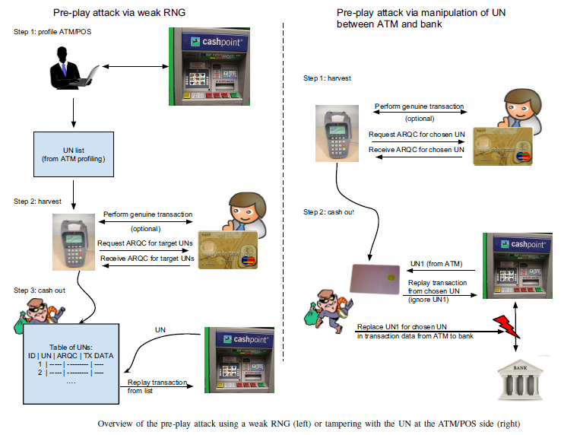
The Two Variant of Pre-play Attack

Slide 18
Defenses
Defenses against random-number attacks
Cryptographically secure random number generator
Include terminal ID in the generation of the ARQC
Reject online transactions where the ATC is lower than the highest ATC seen from that card
Defenses against protocol attacks
Carefully verify the transaction certificate (TC)
Force the card to commit to the value of the ATC before the ATM presents the UN to the card

Slide 19
Conclusion
The paper highlights the poor design choices made in the EMV protocol
The pre-play attack practically destroy every argument that would shift the liability to you
The EMV attack surface is bigger than one might think, especially once crooks learn how to manipulate the protocol.

Slide 20
References
M. Bond, O. Choudary, S. J. Murdoch, S. Skorobogatov and R. Anderson, "Chip and Skim: Cloning EMV Cards with the Pre-play Attack," 2014 IEEE Symposium on Security and Privacy, San Jose, CA, 2014, pp. 49-64. doi: 10.1109/SP.2014.11

Slide 21
Thank You

